Slide 1
Welcome to Week-3
Advanced Programming in Python
By Engr. Imran Khan
Instructor

Slide 2

Python as a calculator
Let us calculate the distance between Edinburgh and London in km
Notes:
Let's run our first block.
That's great
Writing numbers is very tedious
Run this in your notebooks
How can we improve that?

Slide 3
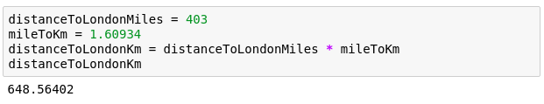
Variables
Great calculator but how can we make it store values?
Do this by defining variables
Can later be called by the variable name
Variable names are case sensitive and unique
Notes:
Can we save values? By defining a variable.
Can have values assigned
Variables must be declared and can then be called by name.
Code example
Check the code yourself

Slide 4

We can now reuse the variable mileToKm in the next block without having to define it again!
Notes:
reuse without having to type in again
Note: mileToKm not defined again

Slide 5
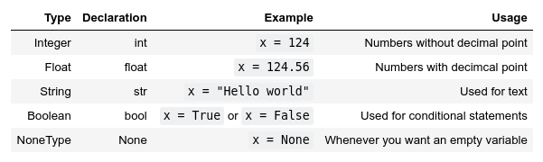
Types
Variables actually have a type, which defines the way it is stored.
The basic types are:
Notes:
So far - storing values in memory; how exactly are they stored?
defined by the type.
Go over all types

Slide 6
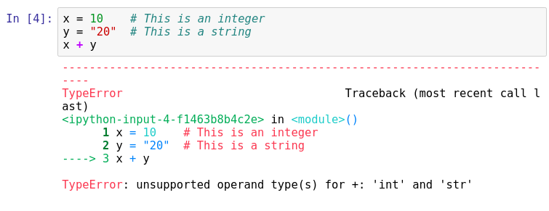
Important lesson to remember!
We can't do arithmetic operations on variables of different types. Therefore make sure that you are always aware of your variables types!
You can find the type of a variable using type(). For example type type(x).
Notes:
Explain code, run it.
we broke python. Any ideas?
Don't be afraid of errors, they are invaluable
we can't add up variables of different types.
important to remember! always take note of what the types of your variables are!
Python is helpful and gives us a hint.
Can you fix this particular block?

Slide 7

Casting types
Luckily Python offers us a way of converting variables to different types!
Casting – the operation of converting a variable to a different type
Similar methods exist for other data types: int(), float(), str()
Notes:
Casting – the operation of converting a variable to a different type
Let's try it on the previous code snippet.
Take note that this works only in a sensible way!

Slide 8

Quick quiz
What will be the result?

Slide 9
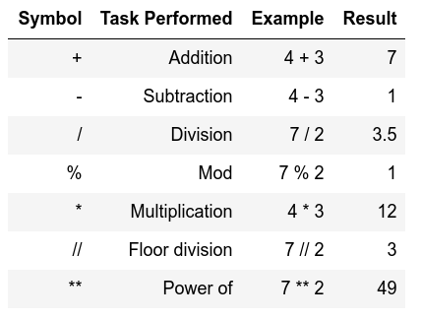
Arithmetic operations
Similar to actual Mathematics.
Order of precedence is the same as in Mathematics.
We can also use parenthesis ()
Notes:
Note of order precedence.
Table doesn't show this
Should be intuitive for all of you.

Slide 10

Order precedence example

Slide 11


Quick quiz
vs
13
49

Slide 12
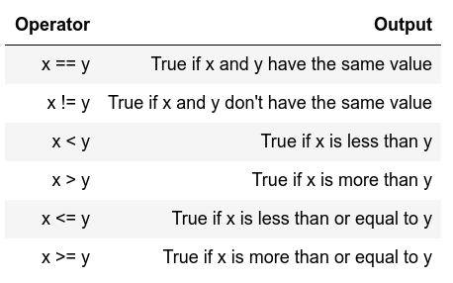
Comparison operators
I.e. comparison operators
Return Boolean values
(i.e. True or False)
Used extensively for conditional statements
Notes:
Similar to mathematics again
Will become important later on.

Slide 13
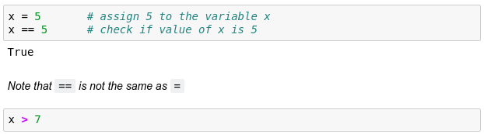
Comparison examples
False
Notes:
Note variable passing down
What will the 2nd block return?

Slide 14
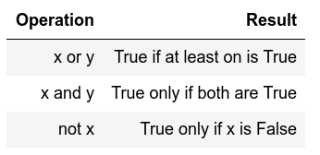
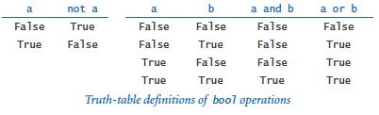
Logical operators
Allows us to extend the conditional logic
Will become essential later on
Notes:
how we can combine comparison operators and logical operators

Slide 15
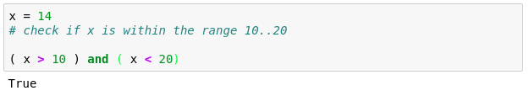
Combining both
True
True

Slide 16
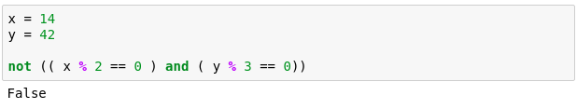
Another example
True
True
True
That wasn't very easy to read was it?
Is there a way we can make it more readable?
Notes:
Another more complex example.
Here we check if x is divisible by 2 and if y is divisible by 3.
Can anybody guess why we are getting False?

Slide 17
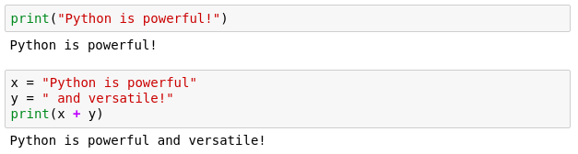
Printing
When writing scripts, your outcomes aren't printed on the terminal.
Thus, you must print them yourself with the print() function.
Beware to not mix up the different type of variables!

Slide 18

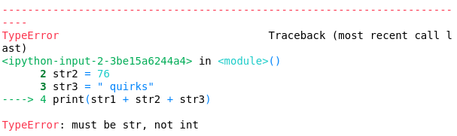
Quick quiz
Do you see anything wrong with this block?
Notes:
Let's see if everybody remembers their types
Is there anything wrong with this block or will it execute nicely?
[issue] Any idea how we can fix it?

Slide 19
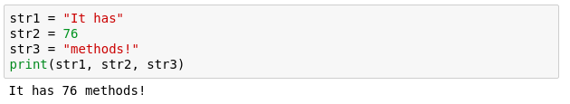
Another more generic way to fix it
If we comma separate statements in a print function we can have different variables printing!

Slide 20
Reserved Words:
Keywords contain lowercase letters only.
and | exec | not
assert | finally | or
break | for | pass
class | from | print
continue | global | raise
def | if | return
del | import | try
elif | in | while
else | is | with
except | lambda | yield

Slide 21
Commenting
Useful when your code needs further explanation. Either for your future self and anybody else.
Useful when you want to remove the code from execution but not permanently
Comments in Python are done with #
Notes:
You seen the # symbols in the slides.
I forget what I write; need to remind my future self
Programmers though it's better to write explanation in between the code
Show example

Slide 22

If Else
Fundamental building block of software
Conditional statement
Executed if answer is True
Executed if answer is False
Notes:
ask very politely "Do you really want to close me", answers Yes and No that is essentially a if-else block.
press Yes the program closes else, you press no and the program continues.
All programs build on if-else blocks, a lot of if-else blocks
The expression in the brackets after the if is the boolean evaluation expression.
If True, execute the code between if and else, if False execute code after else.

Slide 23
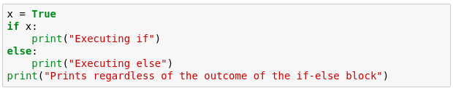
If Else example
Try running the example below.
What do you get?
Notes:
Here is an example that is also included in your notebooks
Go through the example
noticed that the first 2 print statements don't have the same indentation level

Slide 24
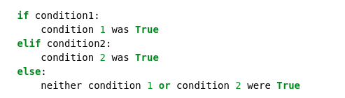
Extending if-else blocks
We can add infinitely more if statements using elif
elif = else + if which means that the previous statements must be false for the current one to evaluate to true
Notes:
extend if block to many different conditions.
done with the elif
previous statements have been false and the current condition is true then execute the current elif block.
Relevant bitcoin example in your code.

Slide 25

For loop
Allows us to iterate over a set amount of variables within a data structure. During that we can manipulate each item however we want
Again, indentation is important here!
Notes:
lists and others are useful when loops
Loops allow us to iterate over containers
For loops are the more controllable
Code explanation
Item is a subset of itemList

Slide 26
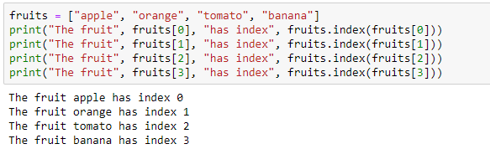
Example
Say we want to go over a list and print each item along with its index
What if we have much more than 4 items in the list, say, 1000?
Notes:
We have 4 copy pasted lines
What if we have more items?
Can we use for?

Slide 27
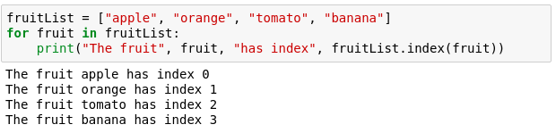
For example
Now with a for loop
Saves us writing more lines
Doesn't limit us in term of size
Notes:
Saves us a few lines of writing
Allows us to not care about size of the list

Slide 28
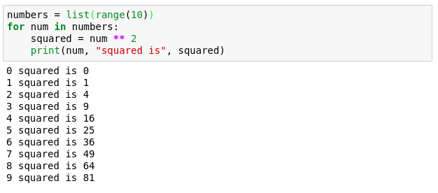
Numerical for loop
Notes:
more useful usage of the for loop.
iterate over 0 to 9 and find the squares

Slide 29
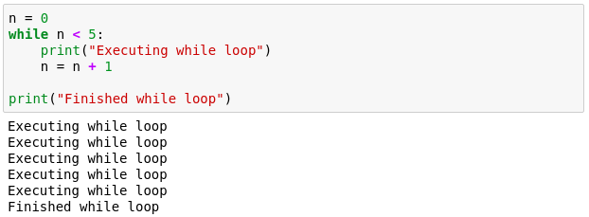
While loop
Another useful loop. Similar to the for loop.
A while loop doesn't run for a predefined number of iterations, like a for loop. Instead, it stops as soon as a given condition becomes true/false.
Notes:
While less controllable than for
Manual control inside.
We must tell it when to stop
While loop that executes 5 times

Slide 30
Break statement
Allows us to go(break) out of a loop preliminary.
Adds a bit of controllability to a while loop.
Usually used with an if.
Can also be used in a for loop.
Notes:
We can also get out of a while whenever we want with break.
Usually used with an if statement
Redo last example
Can also be used in for loops

Slide 31
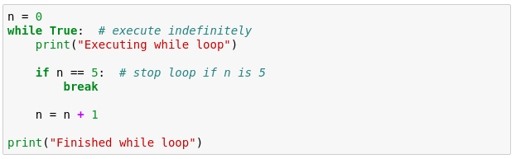
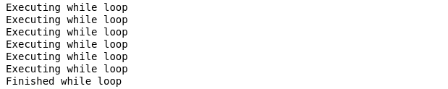
Quick quiz
How many times are we going to execute the while loop?

Slide 32
Continue statement
Allows us to skip the iteration in a loop.
It will automatically go to the next iteration.
Usually used with an for and while loop.
Notes:
We can also get out of a while whenever we want with break.
Usually used with an if statement
Redo last example
Can also be used in for loops

Slide 33
Quick quiz
How many times are we going to execute the while loop?
for i in range(1, 50):
if i%2==0:
continue
else:
print(i)

Slide 34
Functions
Allow us to package functionality in a nice and readable way
reuse it without writing it again
Make code modular and readable
Rule of thumb - if you are planning on using very similar code more than once, it may be worthwhile writing it as a reusable function.
Notes:
Print() is actually a function that we have been using

Slide 35
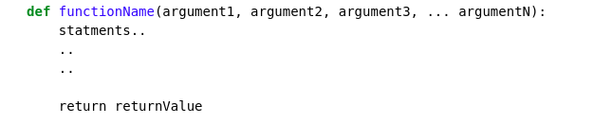
Function declaration
keyword
Any number of arguments
[Optional] Exits the function and returns some value
Functions accept arguments and execute a piece of code
Often they also return values (the result of their code)
Notes:
Go through the declaration

Slide 36
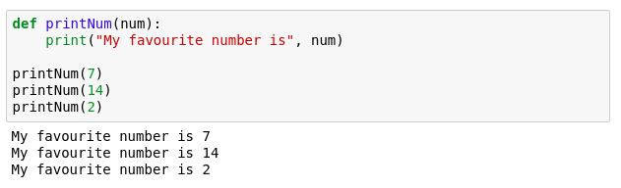
Function example
Notes:
Quick print statement

Slide 37
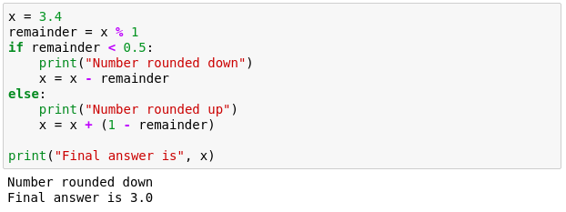
Function example 2
We want to make a program that rounds numbers up or down.
Try to pack the following into a function.
Notes:
more complex problem - rounding a number.
nice an desirable functionality
How can we bundle it and reuse it?

Slide 38
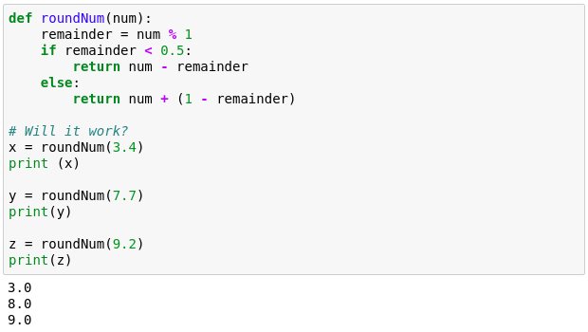
Function example 2
Notes:
Multiline indentation

Slide 39
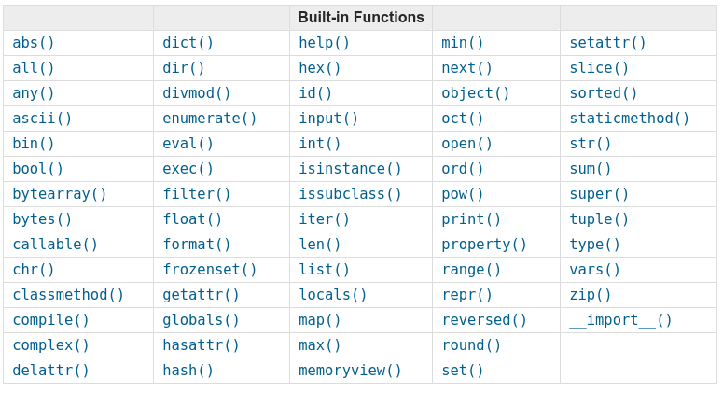
Python built-in functions
To find out how they work: https://docs.python.org/3.3/library/functions.html
Notes:
Every python3 version has these built in functions that you can use however you wish

Slide 40
Python DatesTime
Date is not a data type.
We need to import module named
You can use it by writing “import datetime”
x = datetime.datetime.now()
It has different methods which can be used on requirement
Notes:
Print() is actually a function that we have been using

Slide 41
Python DatesTime
Display the name of the month:
import datetime x = datetime.datetime(2018, 6, 1) print(x.strftime("%B"))
Notes:
Print() is actually a function that we have been using

Slide 42
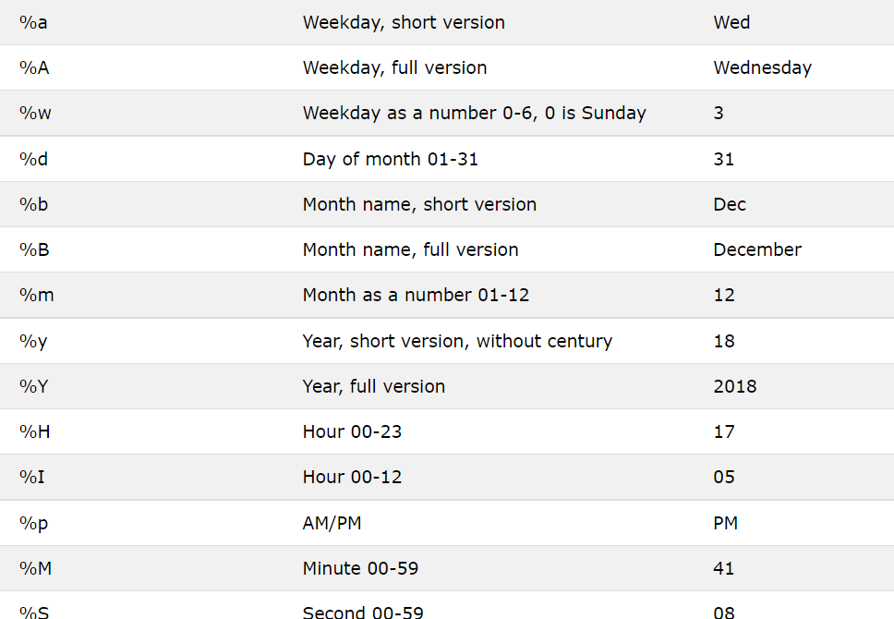
Python DatesTime
Notes:
Print() is actually a function that we have been using

Slide 43
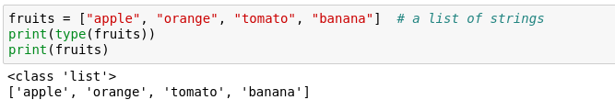
Lists
One of the most useful concepts
Group multiple variables together (a kind of container!)

Slide 44


Indexing a list
Indexing – accessing items within a data structure
Indexing a list is not very intuitive...
The first element of a list has an index 0
Notes:
How to access?
called indexing - not very intuitive.
get a particular item using square brackets

Slide 45
Quick quiz
What will fruits[3] return?

Slide 46
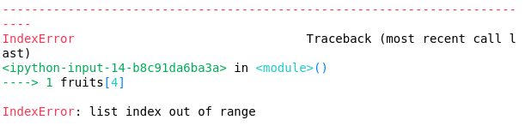
Quick quiz
What will this return?

Slide 47

Data structure sizes
Make sure you are always aware of the sizes of each variable!
This can easily be done using the len() function.
It returns the length/size of any data structure

Slide 48

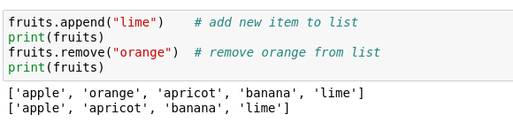
Is a tomato really a fruit?
Furthermore, we can modify lists in various ways
Notes:
serious questions! Is a tomato really a fruit?
Change it
Index item and change its values
we can also add/remove
Done using methods

Slide 49
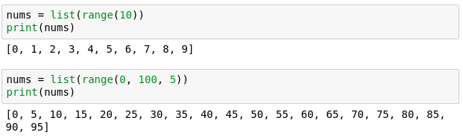
Lists with integers
range() - a function that generates a sequence of numbers as a list
Notes:
something more useful
Can we generate a list of numbers easily?
Yes, using the built in func. Range()
This is useful for generating plots for example.
Let us look at how we can make something with it

Slide 50
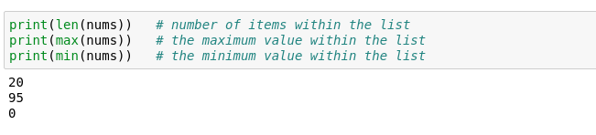
Lists – helpful functions
Makes them extremely useful and versatile
Notes:
Lists can also be put in other functions which might prove helpful.
*Give examples of the 3 methods*

Slide 51

Lists can be of different types
Not very useful, but possible

Slide 52
Mutability
Mutable object – can be changed after creation.
Immutable object - can NOT be changed after creation.

Slide 53
Quick quiz
Are lists mutable?

Slide 54
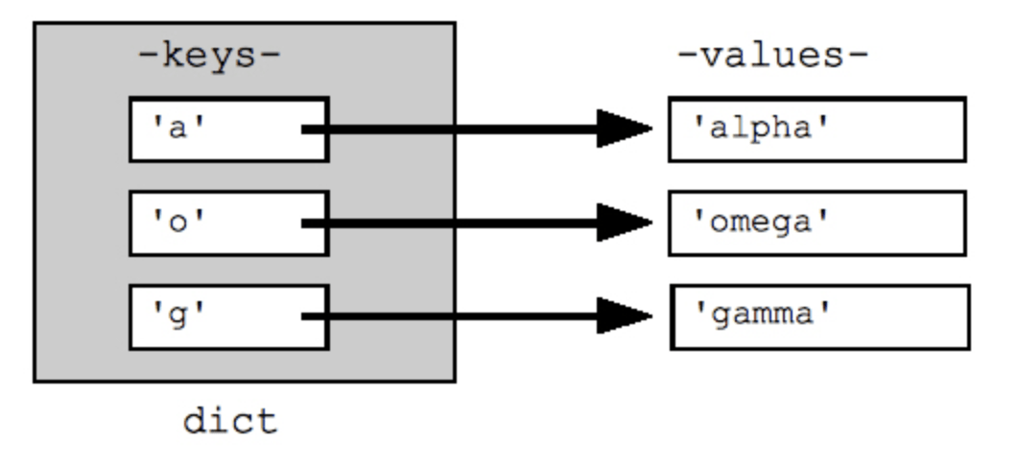
Dictionaries
Similar to actual dictionaries
They are effectively 2 lists combined – keys and values
We use the keys to access the values instead of indexing them like a list
Each value is mapped to a unique key
Notes:
similar to actual dictionaries.
effectively 2 lists combined - keys and values
Example - days of the week in Gaelic mapped to their English translations

Slide 55

Dictionary definition
Defined as comma separated key : value pairs:
Comma separated
Curly brackets
Notes:
Note curly brackets and colons

Slide 56
Dictionary properties
Values are mapped to a key
Values are accessed by their key
Key are unique and are immutable
Values cannot exist without a key

Slide 57
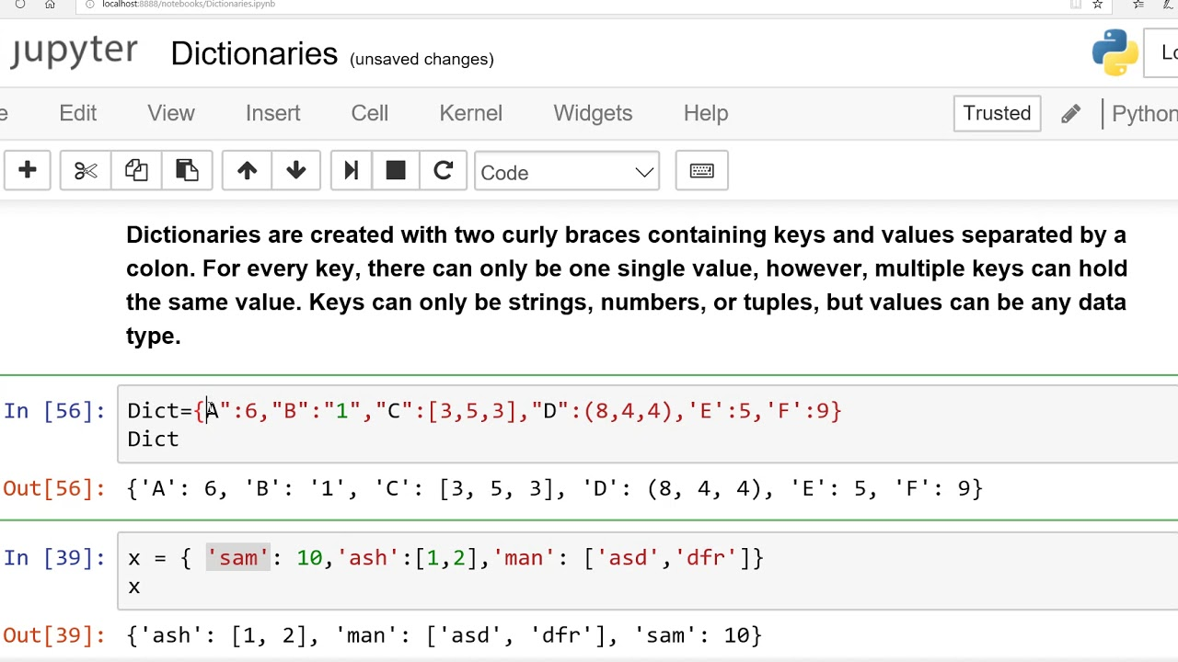
Dictionaries
Let us define the one from the previous image

Slide 58

Accessing a dictionary
Values are accessed by their keys (just like a dictionary)
Note that they can't be indexed like a list
Notes:
Give example of how you access a dictionary in real life.
Say we want to look up the Gaelic translation of Friday?

Slide 59
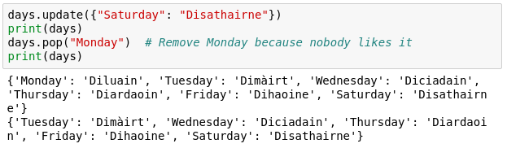
Altering a dictionary
Can be done via the dictionary methods
Notes:
Note that they are not the same as for lists for obvious reasons
We are not going to go over all methods for dicts
You can find them using the dir('dict')
Or simply by googling afterwards

Slide 60
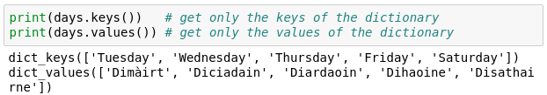
Keys and Values
It is possible to obtain only the keys or values of a dictionary.
This is useful for iteration.

Slide 61
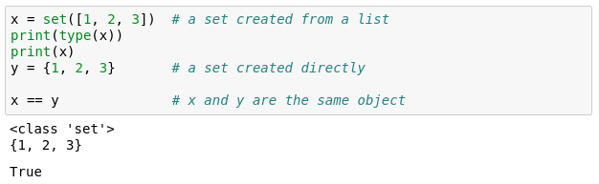
Sets
Effectively lists that can't contain duplicate items
Similar functionality to lists
Can't be indexed or sliced
Can be created with {} or you can convert a list to a set
Notes:
Essentially a list of unique items

Slide 62
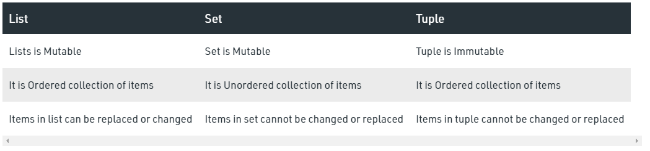
Notes:
Essentially a list of unique items

Slide 63
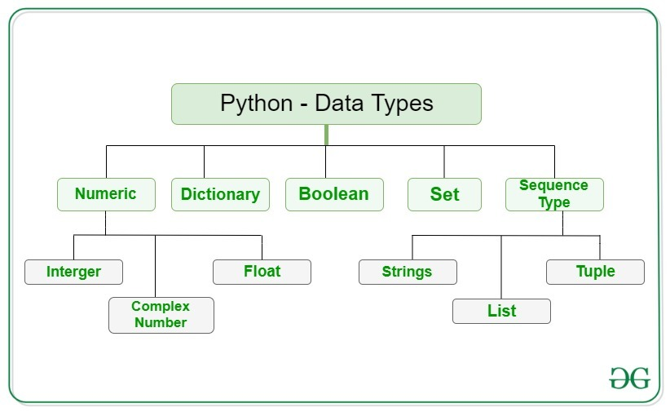
Notes:
You seen the # symbols in the slides.
I forget what I write; need to remind my future self
Programmers though it's better to write explanation in between the code
Show example

Slide 64
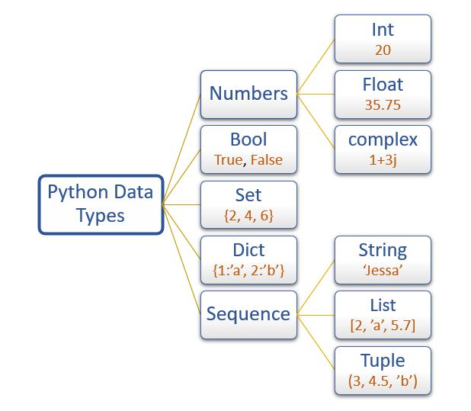
Notes:
You seen the # symbols in the slides.
I forget what I write; need to remind my future self
Programmers though it's better to write explanation in between the code
Show example

Slide 65
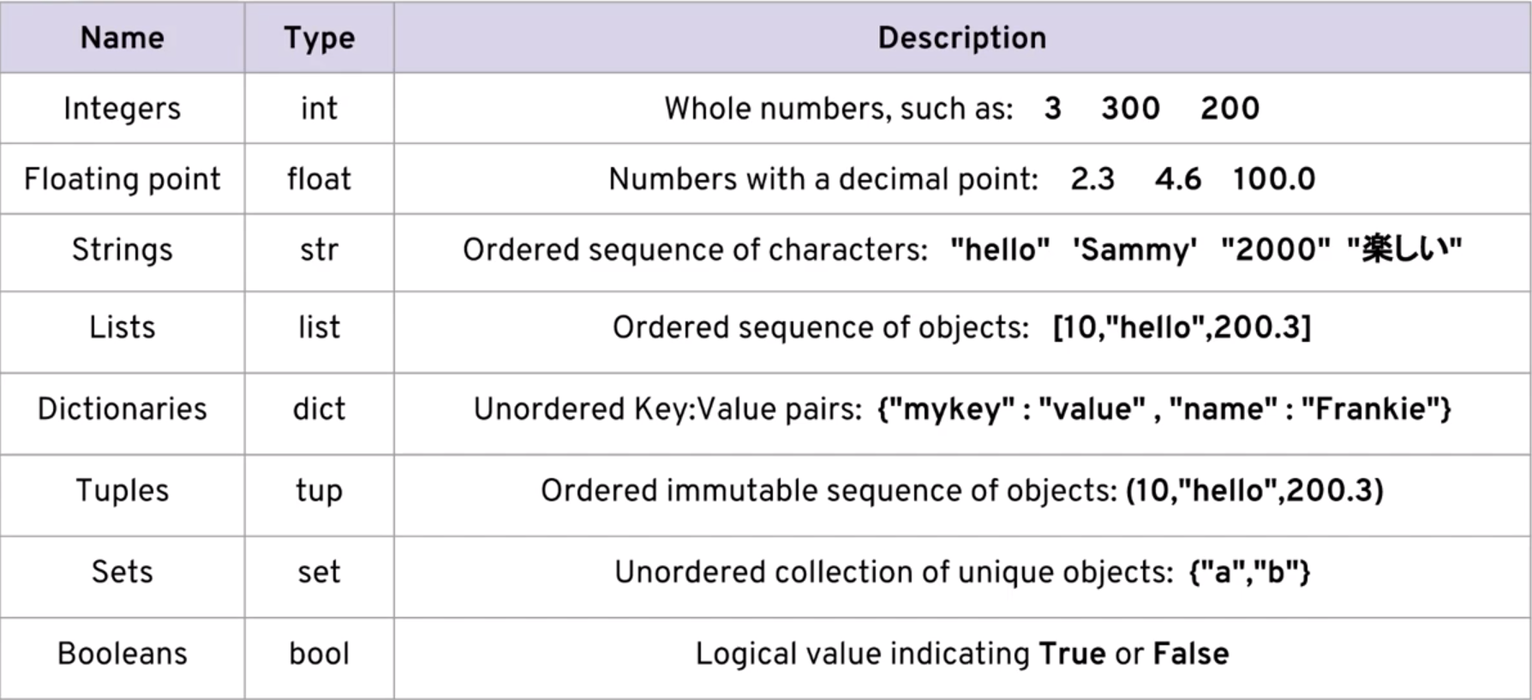
Notes:
You seen the # symbols in the slides.
I forget what I write; need to remind my future self
Programmers though it's better to write explanation in between the code
Show example

Slide 66
I HOPE YOU LEARN A LOT & ENJOY THE TRAINING! THANK YOU ☺

